Slide 1
Computer Architecture
A Quantitative Approach, Sixth Edition
Chapter 2
Memory Hierarchy Design
Part 1: The Basics
“Ideally one would desire an indefinitely large memory capacity such that any particular … word would be immediately available. … We are … forced to recognize the possibility of constructing a hierarchy of memories, each of which has greater capacity than the preceding but which is less quickly accessible.”
– A. W. Burks, H. H. Goldstine, and J. von Neumann, Preliminary Discussion of the Logical Design of an Electronic Computing Instrument (1946)

Slide 2
Acknowledgements
Thanks to many sources for slide material
© 1990 Morgan Kaufmann Publishers, © 2001-present Elsevier
Computer Architecture: A Quantitative Approach by J. Hennessy & D. Patterson
© 1994 Morgan Kaufmann Publishers, © 2001-present Elsevier
Computer Organization and Design by D. Patterson & J. Hennessy
© 2002 K. Asinovic & Arvind, MIT
© 2002 J. Kubiatowicz, University of California at Berkeley
© 2006, © 2010 No Starch Press for Inside the Machine by J. Stokes
© 2007 W.-M. Hwu & D. Kirk, University of Illinois & NVIDIA
© 2007-2010 J. Owens, University of California at Davis
© 2010 CRC Press for Introduction to Concurrency in Programming Languages by M. Sottile, T. Mattson, and C. Rasmussen
© 2017, IBM POWER9 Processor Architecture by Sadasivam et al., IBM
© 2016, © 2019 POWER9 Processor User’s Manual, IBM
© The OpenPOWER Foundation

Slide 3
Introduction
What do programmers want?
Unlimited amounts of memory with low latency
Problem:
Fast memory more expensive per bit than slower memory
Solution: Organize memory system into a hierarchy
Entire addressable memory available in largest, slowest memory
Incrementally smaller and faster memories, each containing a subset of the memory below it, proceed in steps up toward the processor
Outcome: Deliver illusion of a fast & large memory to CPU
How? Temporal locality and spatial locality ensure that nearly all references can be found in smaller memories

Slide 4
Memory Hierarchy
Key: $ = cache
L1
$
L2
$
L3
$
Memory
Disk Storage
CPU
Memory
bus
I/O
bus
Registers
Register
reference
Level 1 $
reference
Level 2 $
reference
Level 3 $
reference
Memory
reference
Disk memory
reference
Size:
Speed:
1000 bytes
0.3 ns
64 kB
1 ns
256 kB
3-10 ns
8-16 MB
20-30 ns
8-16 GB
80-100 ns
1-8 TB
5,000,000-10,000,000 ns
L1
$
L2
$
Memory
FLASH Memory
CPU
Memory
bus
I/O
bus
Registers
Register
reference
Level 1 $
reference
Level 2 $
reference
Memory
reference
FLASH memory
reference
Size:
Speed:
500 bytes
0.3 ns
64 kB
2 ns
256 kB
10-20 ns
4-6 GB
80-100 ns
256-512 GB
25,000-50,000 ns

Slide 5
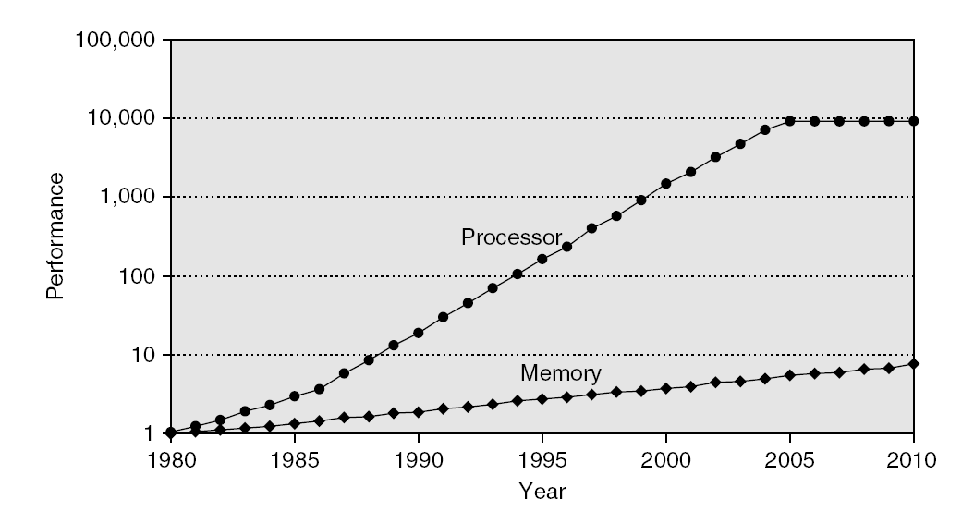
Cache: Multicore Feature of Interest
Introduced in the 1960s as a way to overcome the “memory wall”
Memory speeds did not advance as fast as the speed of functional units.
Consequence: Processor outruns memory, leading to decreased utilization
Notes:
Utilization = (t_{total} – t_{idle}) / t_{total}
Atharva: Extend this graph from 2010 to 2020.

Slide 6
Idle Time
What happens when you go out to main memory?
Idle time.
Decreased utilization = less work per unit time
Idle time = time doing nothing = $$$ wasted
Overcoming the “Memory Wall”
Caches were not the sole ﬁx for idle time.
Early Days: Preemptive multitasking and time sharing were actually the dominant methods.
... but every program inevitably must go out to memory ... not always enough jobs to swap in while others wait for memory … also, do you really want to be preempted every time you fetch data?
So, caches important (for now :-) …
Notes:
Utilization = (t_{total} – t_{idle}) / t_{total}

Slide 7
Memory Hierarchy Design
Memory hierarchy design becomes more crucial with recent multi-core processors
Aggregate peak bandwidth grows with # cores:
Intel Core i7 can generate two references per core per clock
Four cores and 3.2 GHz clock
How much memory bandwidth needed?
Hint: 64-bit data references & 128-bit instruction references
DRAM bandwidth is only 25 GB/s (circa 2011-2012)
How to bridge the gap?
Multi-port, pipelined caches
Two levels of cache per core
Shared third-level cache on chip
Notes:
QUIZ?
Assuming a 64-bit architecture:
Data References: 25.6 billion 64-bit data references/second +
Instruction References: 12.8 billion 128-bit instruction references/second
= 409.6 GB/s!
How to bridge the gap? How to give the illusion of a large, fast memory being presented to the processor?

Slide 8
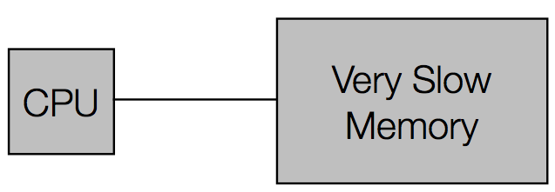
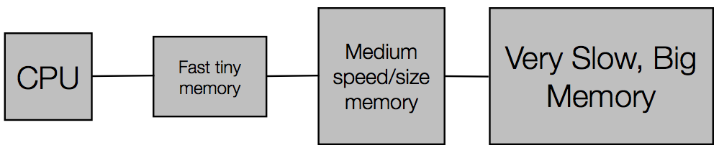
Caches: An Overview
Traditional Single-Level Memory
Multiple Memory Levels

Slide 9
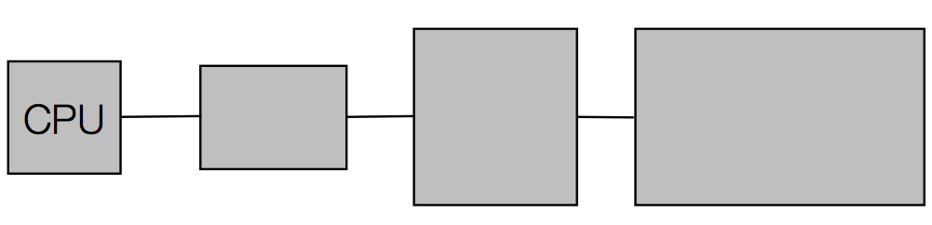
Caches: In Action
Access a location in memory
Copy the location and its neighbors into the faster memories closer to the CPU.

Slide 10
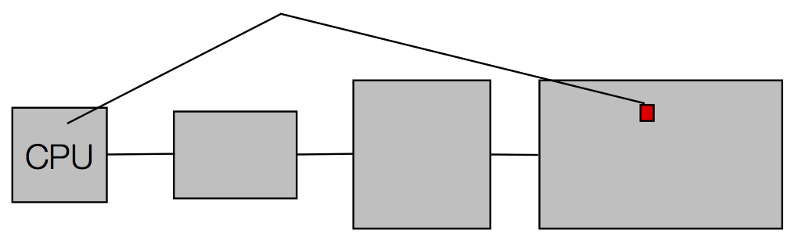
Caches: In Action
Access a location in memory
Copy the location and its neighbors into the faster memories closer to the CPU.

Slide 11
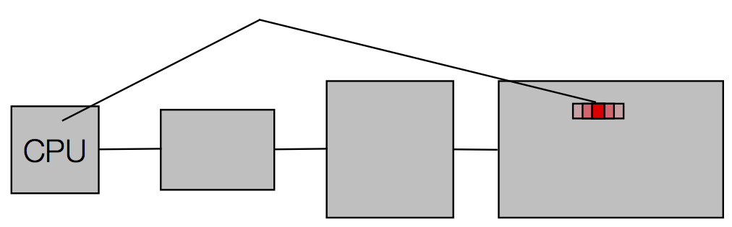
Caches: In Action
Access a location in memory
Copy the location and its neighbors into the faster memories closer to the CPU.

Slide 12
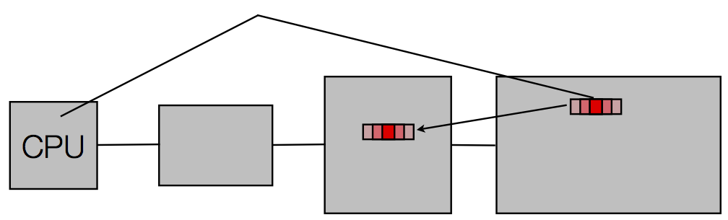
Caches: In Action
Access a location in memory
Copy the location and its neighbors into the faster memories closer to the CPU.

Slide 13
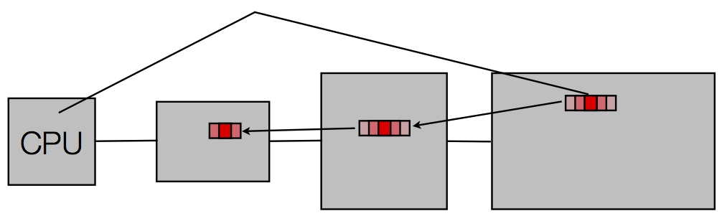
Caches: In Action
Access a location in memory
Copy the location and its neighbors into the faster memories closer to the CPU.

Slide 14
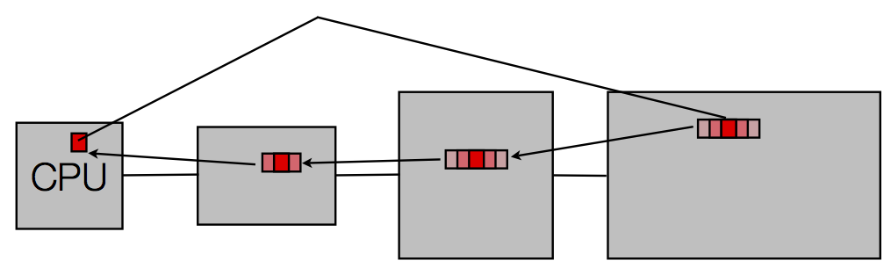
Caches: In Action
Access a location in memory
Copy the location and its neighbors into the faster memories closer to the CPU.

Slide 15
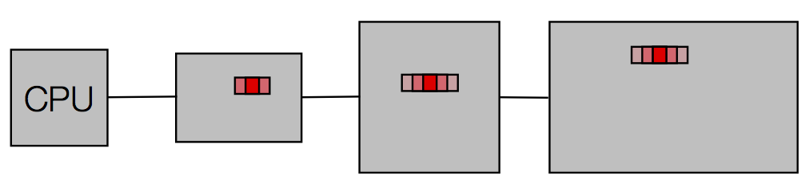
Caches: In Action
Next time you access memory, if you already pulled the address into one of the cache levels in a previous access, the value is provided from the cache.

Slide 16
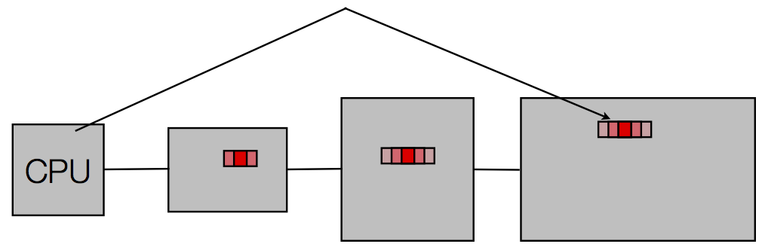
Caches: In Action
Next time you access memory, if you already pulled the address into one of the cache levels in a previous access, the value is provided from the cache.

Slide 17
Caches: In Action
Next time you access memory, if you already pulled the address into one of the cache levels in a previous access, the value is provided from the cache.

Slide 18
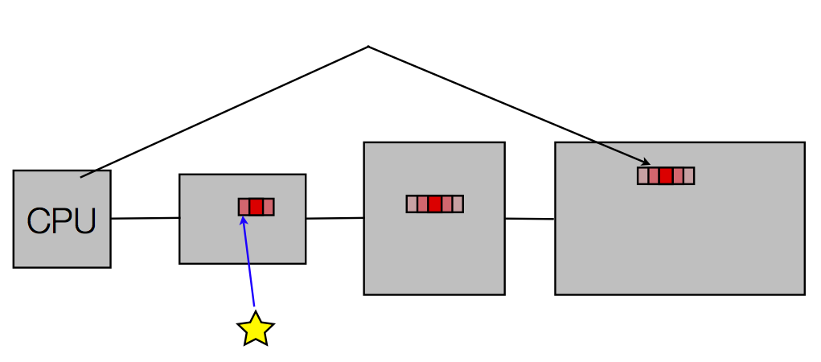
Caches: In Action
Next time you access memory, if you already pulled the address into one of the cache levels in a previous access, the value is provided from the cache.

Slide 19
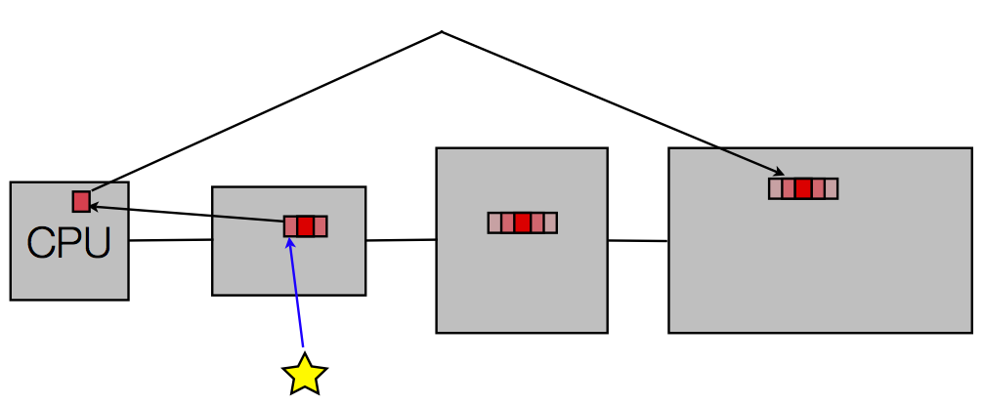
Caches: In Action
Next time you access memory, if you already pulled the address into one of the cache levels in a previous access, the value is provided from the cache.

Slide 20
Why Do Caches Work? Locality
Spatial and Temporal
Locations near each other in space (address) are highly likely to be accessed near each other in time.
Cost?
A high cost for one access but amortize this out with faster accesses afterwards.
Burden?
The machine makes sure that memory is kept consistent. If a part of cache must be reused, the cache system writes the data back to main memory before overwriting it with new data.
Hardware cache design deals with managing mappings between the different levels and deciding when to write back down the hierarchy.

Slide 21
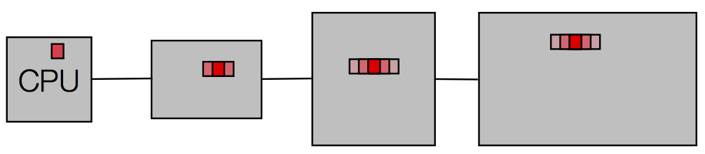
Caches: Memory Consistency?
What happens when you modify something in memory?

Slide 22
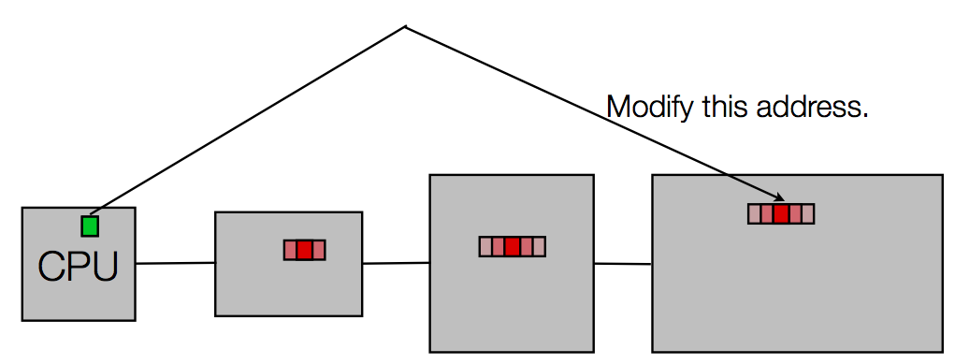
Caches: Memory Consistency?
What happens when you modify something in memory?

Slide 23
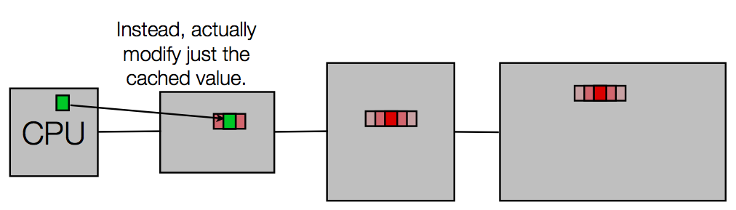
Caches: Memory Consistency?
What happens when you modify something in memory?
Writes to memory become cheap. Only go to slow memories when needed. Called write-back memory.

Slide 24
Caches: Memory Consistency?
Eventually written values must make it back to the main store.
When?
Typically, when a cache block is replaced due to a cache miss, where new data must take the place of old.
The programmer does NOT see this.
Hardware takes care of all this … but things can go wrong very quickly when you modify this model.
Example: Cell Broadband Engine, Tilera, and so on.

Slide 25
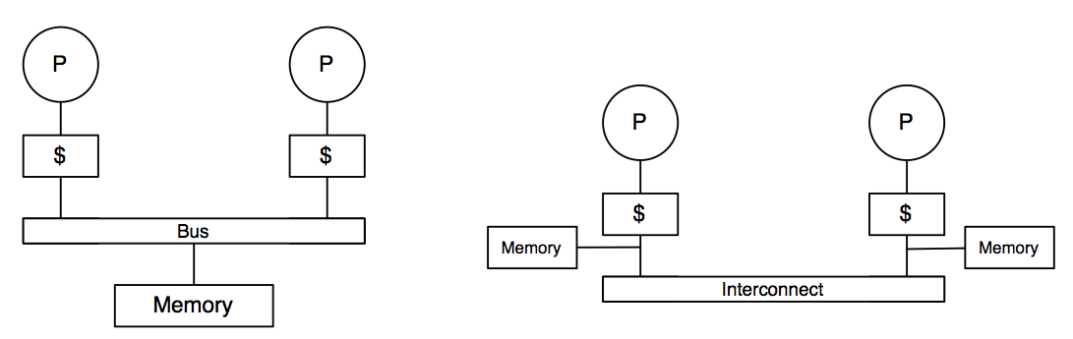
Common Memory Models
Shared Memory Architecture
Distributed Memory Architecture
Notes:
Which was Intel? Which is AMD? Others?

Slide 26
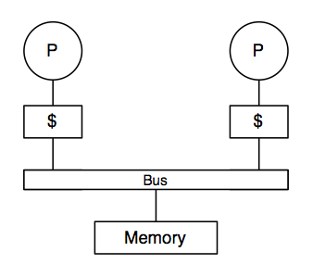
Memory Models: Shared Memory
Before
Only one processor has access to modify memory.
How do we avoid problems when multiple cache hierarchies see the same memory?

Slide 27
Caching Issues
Assume two processors load
locations that are neighbors,
so data is replicated in the local processor caches.
Now, let one processor modify a value.
The memory view is now inconsistent. One processor sees one version of memory, the other sees a different version.
How do we resolve this in hardware such that the advantages of caches are still seen by application developers in terms of performance while ensuring a consistent (or coherent) view of memory?

Slide 28
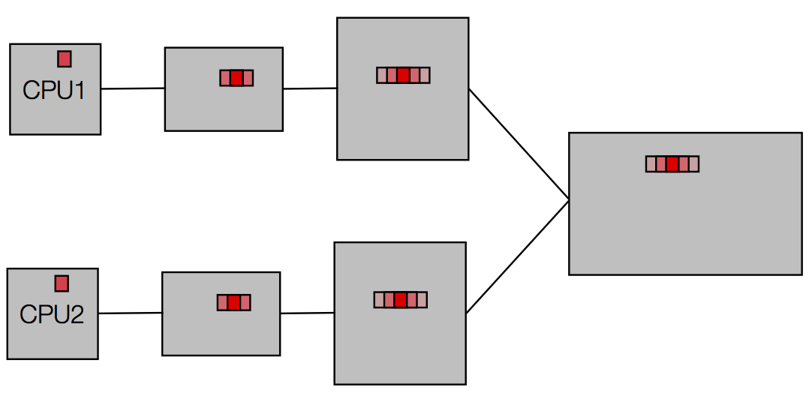
Caching Issues

Slide 29
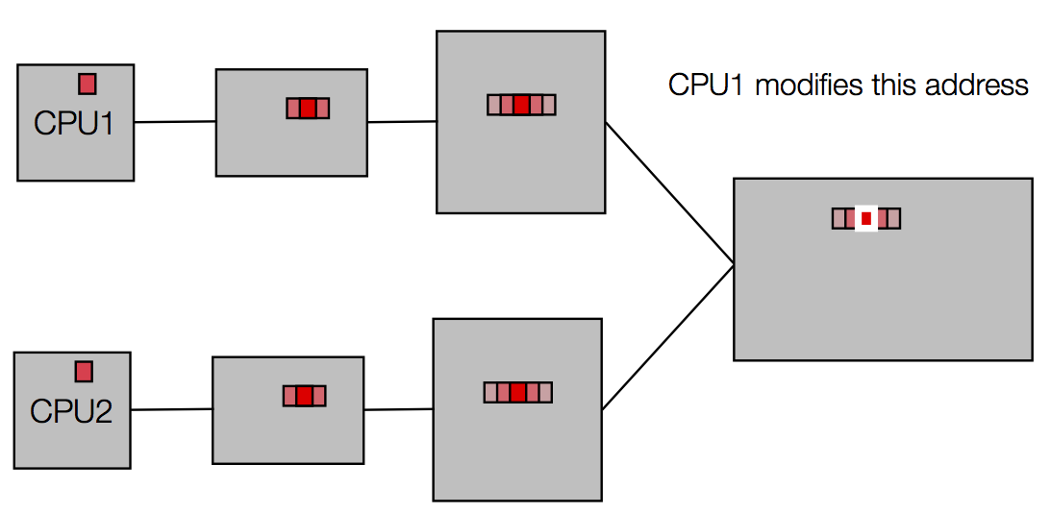
Caching Issues

Slide 30
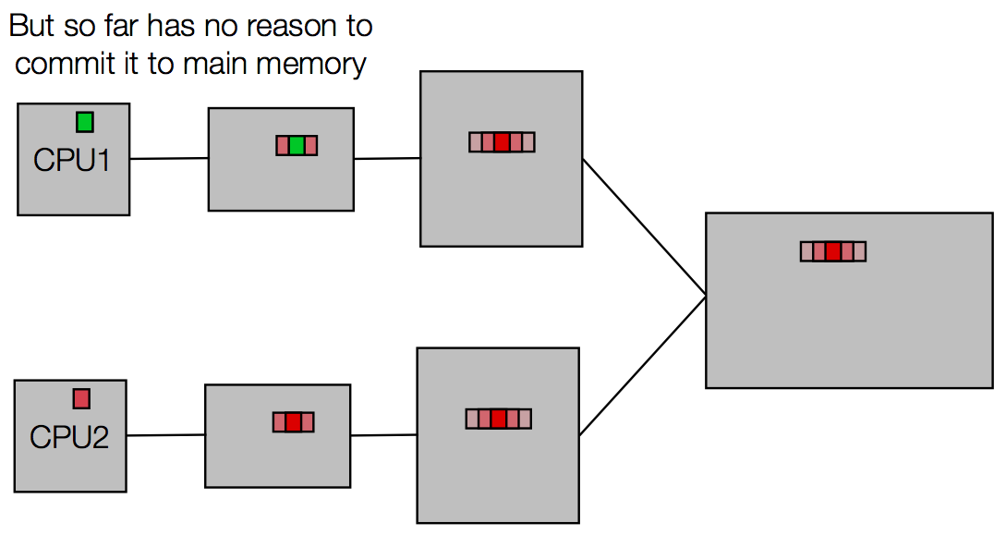
Caching Issues

Slide 31
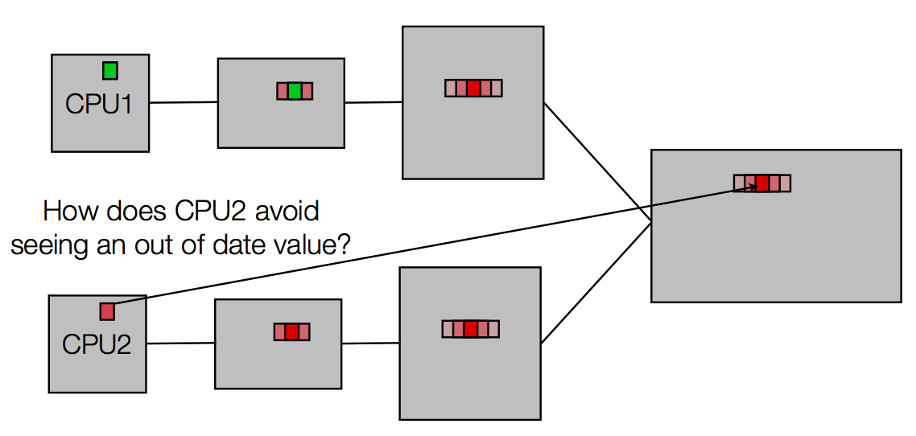
Caching Issues

Slide 32
Caching: Memory Consistency?
Easy to see “memory consistency” problem if we restrict each cache hierarchy to being isolated from the others, only sharing main memory.
Key insight
Make this inconsistency “go away” by making the caches aware of each other.

Slide 33
What is Memory Coherence?
Definition (Courtesy: “Parallel Computer Architecture” by Culler and Singh)
Operations issued by any particular process occur in the order in which they were issued to the memory system by that process.
The value returned by each read operation is the value written by the last write to that location in the serial order.
Assumption: The above requires a hypothetical ordering for all read/write operations by all processes into a total order that is consistent with the results of the overall execution.
Sequential Consistency (SC)
The memory coherence hardware assists in enforcing SC.

Slide 34
Implicit Properties of Coherence
The key to solving the cache-coherence problem is the hardware implementation of a cache-coherence protocol.
A cache-coherence protocol takes advantage of two hardware features
State annotations for each cache block (often just a couple bits per block).
Exclusive access to the bus by any accessing process.
Notes:
What does “exclusive access to the bus” imply?

Slide 35
Bus Properties
All processors on the bus see the same activity.
Every cache controller sees bus activity in the same order.
Serialization at the bus level results from the phases that compose a bus transaction:
Bus arbitration: The bus arbiter grants exclusive access to issue commands onto the bus.
Command/address: The operation to perform (“Read”, “Write”), and the address.
Data: The data is then transferred.
Notes:
At what granularity is the data transferred?

Slide 36
Granularity
Cache coherence applies at the block level.
Recall that when you access a location in memory, that location and its neighbors are pulled into the cache(s). These are blocks.
Note: To simplify the discussion, we will only consider a single level of cache. The same ideas translate to deeper cache hierarchies.

Slide 37
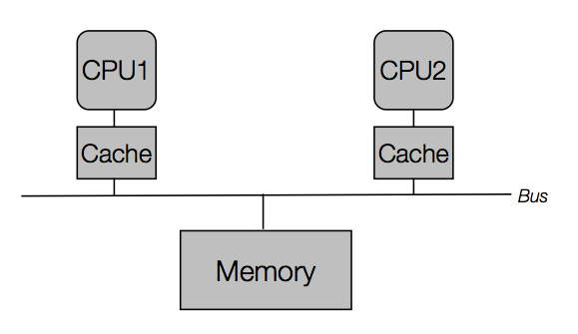
Cache Coherency via the Bus
Key Idea: Bus Snooping
All CPUs on the bus can see activity on the bus regardless of if they initiated it.

Slide 38
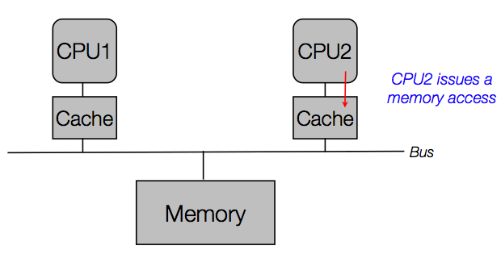
Cache Coherency via the Bus
Key Idea: Bus Snooping
All CPUs on the bus can see activity on the bus regardless of if they initiated it.

Slide 39
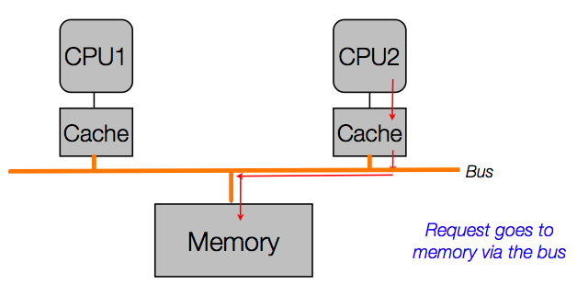
Cache Coherency via the Bus
Key Idea: Bus Snooping
All CPUs on the bus can see activity on the bus regardless of if they initiated it.

Slide 40
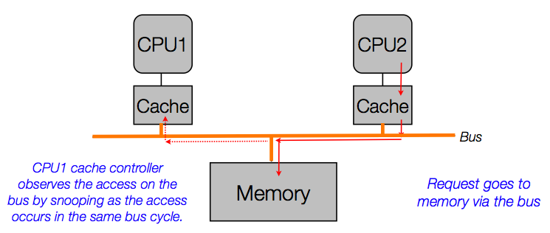
Cache Coherency via the Bus
Key Idea: Bus Snooping
All CPUs on the bus can see activity on the bus regardless of if they initiated it.

Slide 41
Invalidation vs. Update
A cache controller snoops and sees a write to a location that it has a now-outdated copy of.
What does it do?
Invalidation
Mark cache block as invalid, so when CPU accesses it again, a miss will result and the updated data from main memory will be loaded. Requires one bit per block to implement.
Update
See the write and update the caches with the value observed being written to main memory.
Notes:
Invalidation-based protocols vs. update-based protocols

Slide 42
CACHING: UNDER THE COVERS

Slide 43
Performance and Power
High-end microprocessors have > 10 MB on-chip cache
Consumes large amount of area and power budget

Slide 44
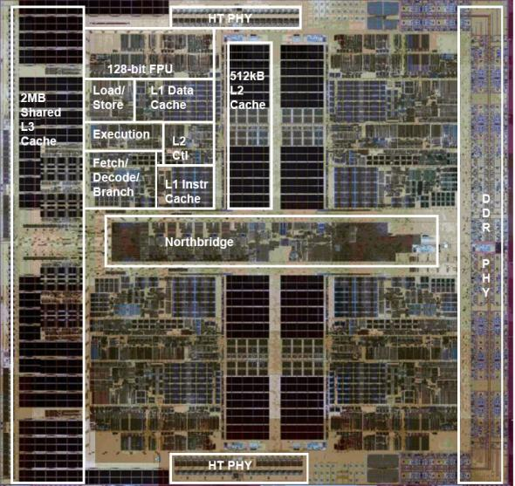
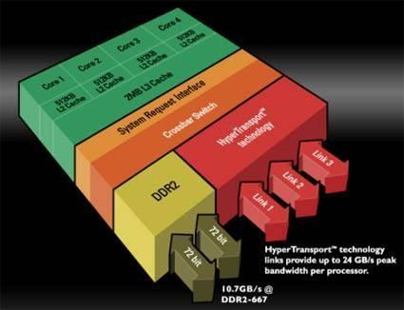
AMD Opteron Rev. H Quad-Core
Where are the caches?

Slide 45
IBM: Power9
Source: IBM

Slide 46
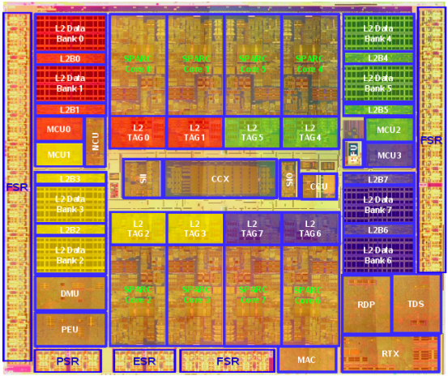
Sun Niagara
8 cores, 8 threads per core = 64 threads

Slide 47
Intel Skylake

Slide 48
Memory Hierarchy: Algorithm
When a word is not found in the cache, a miss occurs
Fetch word from lower level in hierarchy, requiring a higher latency reference
Lower level may be another cache or the main memory
Also fetch the other words contained within the block
Takes advantage of spatial locality
Place block into cache in any location within its set, determined by address
block address MOD number of sets

Slide 49
When to Write Blocks: Strategies to Write to the Cache
Write-Back
Only update lower levels of hierarchy when an updated block is replaced
On a write miss, the CPU reads the entire block from memory where the write address is, updates the value in cache, and marks the block as modified (aka dirty).
Write-Through
Immediately update lower levels of hierarchy
When the processor writes, even to a block in cache, a bus write is generated.
Both strategies use write buffer to make writes asynchronous
Write-back is more efficient with respect to bandwidth usage on the bus, and hence, ubiquitously adopted.
Notes:
Write buffer allows the cache to proceed as soon as the data is placed in the buffer rather than wait the full latency to write the data into memory.

Slide 50
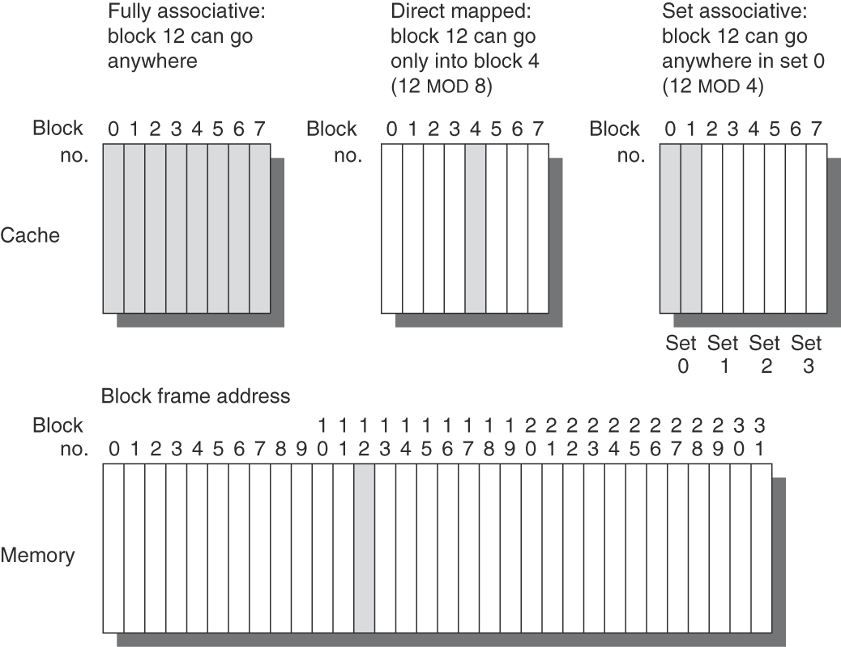
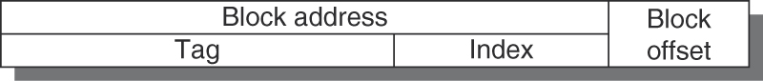
Where to Write Blocks: Associativity
How is the cache organized?
n-way set associative, where n = # of blocks per set
Direct-mapped cache (1-way set associative) → one block per set
Fully associative cache (n-way set associative) → n blocks in one set
Tag | Index | Offset
xx | 000 | 00
xx | 001 | 00
xx | 010 | 00
xx | 011 | 00
xx | 100 | 00
xx | 101 | 00
xx | 110 | 00
xx | 111 | 00
Tag | Index | Offset
xxx | 00 | 00
xxx | 01 | 00
xxx | 10 | 00
xxx | 11 | 00
block address MOD number of sets
block
address
block
address
Notes:
Fully associative (1 set of 8 blocks) | Direct-mapped (8 sets of 1 block) | Set Associative (4 sets of 2 blocks)
32-block main memory. Assume 4 bytes per block.
Assume each block is 4 bytes (for simplicity)
Tag Blk Offset
xx 000 00 block 00000 (0), block 01000 (8), block 10000 (16), block 11000 (24)
xx 001 00
xx 010 00

Slide 51
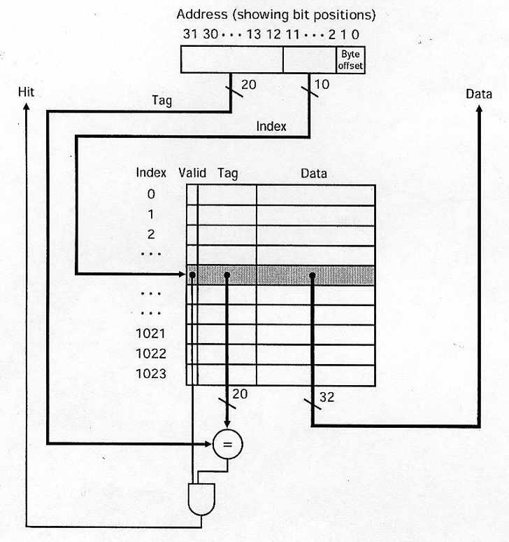
Where to Write Blocks: Associativity

Slide 52
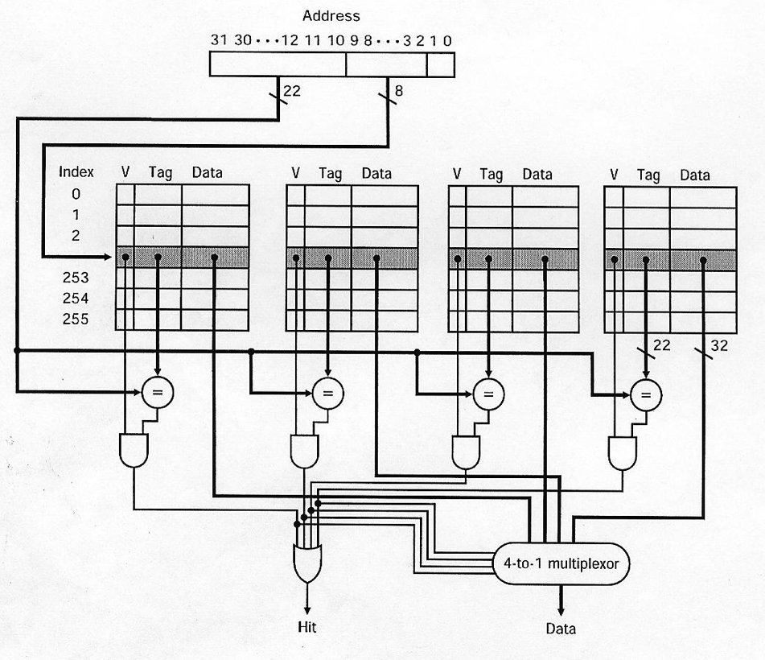
Where to Write Blocks: Associativity

Slide 53
How to Evaluate Cache Organization: Miss Rate
Miss Rate
Fraction of cache access that result in a miss
Causes of Misses
Compulsory
First reference to a block
Capacity
Blocks discarded and later retrieved
Conflict
Program makes repeated references to multiple addresses from different blocks that map to the same location in the cache

Slide 54
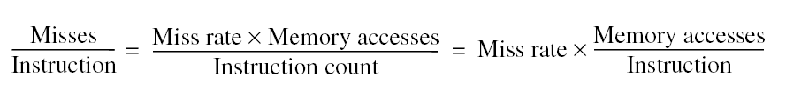
Other Metrics?
Note: Speculative and multithreaded processors may execute other instructions during a miss
Reduces performance impact of misses
Notes:
Miss rate can be a misleading measure. Why?
Hence, misses per instruction (rather than misses per memory reference).
Problem with BOTH above measures: Do NOT factor in the COST of a miss.

Slide 55
Basic Cache Optimizations
Larger block size
Reduces compulsory misses
Increases capacity and conflict misses, increases miss penalty
Larger total cache capacity to reduce miss rate
Increases hit time, increases power consumption
Higher associativity
Reduces conflict misses
Increases hit time, increases power consumption
Higher number of cache levels
Reduces overall memory access time, increases complexity
Giving priority to read misses over writes
Reduces miss penalty, increases complexity
Avoiding address translation in cache indexing
Reduces hit time
Notes:
Caching must cope with translation of virtual address to physical address.
Common optimization: Use the page offset, i.e., the part that is identical in both virtual and physical addresses, to index the cache.

